Slide 1
ARDS and Dead Space: the motor of VILI
Antonio Pesenti
antonio.pesenti@unimi.it

Slide 2
Conflicts of Interest
INSTITUTIONAL:
  Research grants from:
    Draeger
    Maquet
    Fisher-Paykel
PERSONAL ( Consulting)
  Maquet, Novalung, Gambro
Patents applied/granted on extracorporeal gas exchange and mechanical ventilators

Slide 3
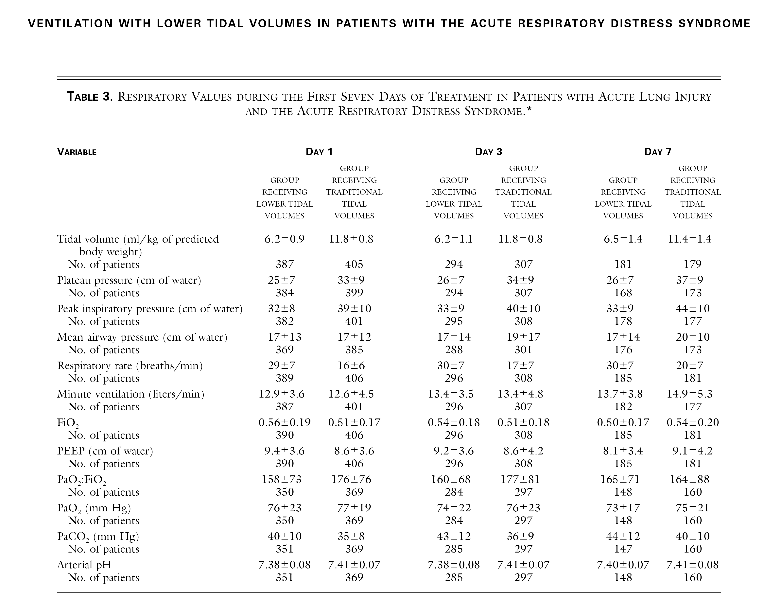
ARMA trial NEJM 2000

Slide 4
Anatomic VD
Alveolar VD
Ideal

Slide 5
Dead space
is a motor of
VILI

Slide 6
VCO2= 240 ml/min
Ve= Vd anat+ VA
6 L = 2.0 + 4 L
Vd anat = 2L
VA = 1.33L
PACO2 43
VA = 1.33L
PACO2 43
Palv 20
VA = 1.33L
PACO2 43
PvCO2= 49 mmHg
VCO2 = 240 ml
Crs (each) 10
ART PaCO2 = 43mmHg

Slide 7
VCO2= 240 ml/min
Ve= Vd anat+ Vd alv +VA
8 L = 2L + 2 L+4L
Vd anat = 2L
Palv 49
VD ALV
2 L
VA = 2 L
PACO2 43
Palv 27
VA = 2 L
PACO2 43
PvCO2= 49 mmHg
VCO2 = 240 ml
Crs (each) 10
ART PaCO2 = 43mmHg

Slide 8
VCO2= 240 ml/min
Ve= Vd Alv + Vd anat+ VA
11.8 L = 4.9+ 2 + 4.9 L
Vd anat = 2L
Palv 54
VD ALV
4.9 L
VA = 4.9 L
PACO2 43
PcCO2= 35 mmHg
PvCO2= 49 mmHg
VCO2 = 240 ml
Crs (each) 10
ART PaCO2 = 43mmHg

Slide 9
PECO2 =( 43*4 ) / 8 = 21.5 mmHg
Vd/Vt = (43-21.5)/ 43 = 0.5

Slide 10
PECO2 =( 43*4 ) / 8 = 21.5 mmHg
Vd/Vt = (43-21,5)/ 43 = 0.5
Because of shunt
PECO2 =( 35* 4.9) /11.8 = 14.5 mmHg
Vd/Vt = (43-14.5)/ 43 = 0.66

Slide 11
Dead space
is a motor of
VILI
It increases Volume and Pressure load
Because ventilation damages the unperfused tissue

Slide 12
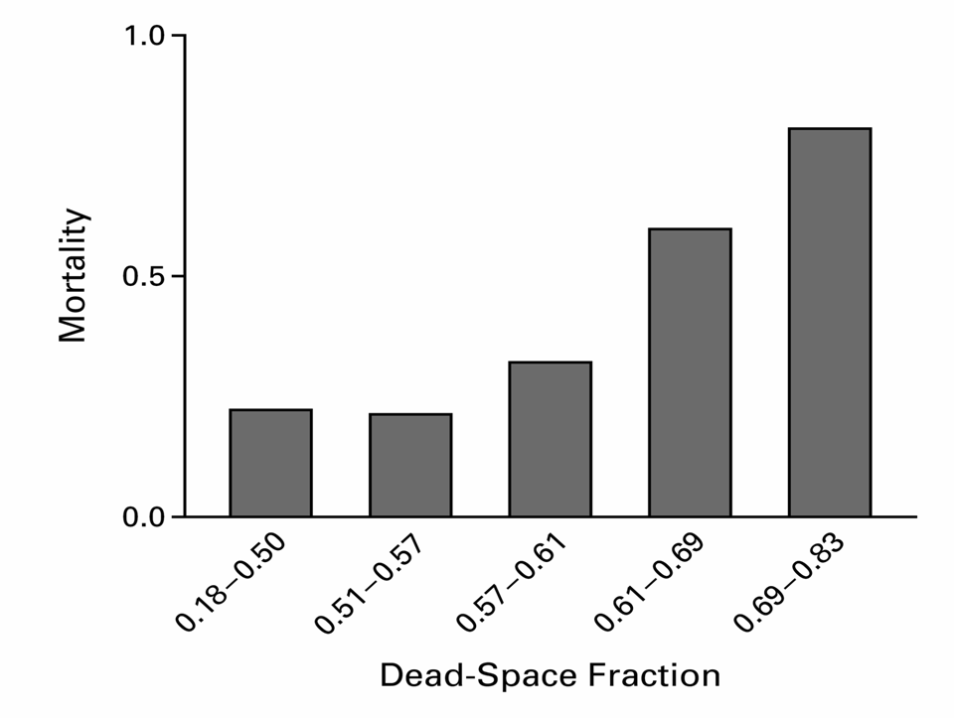
NEJM 2002:346: 1281
Notes:
N Engl J Med. 2002 Apr 25;346(17):1281-6. Comment in: N Engl J Med. 2002 Sep 12;347(11):850-2; author reply 850-2. N Engl J Med. 2002 Sep 12;347(11):850-2; author reply 850-2. N Engl J Med. 2002 Sep 12;347(11):850-2; author reply 850-2. N Engl J Med. 2002 Sep 12;347(11):850-2; author reply 850-2. N Engl J Med. 2002 Sep 12;347(11):850-2; author reply 850-2. Pulmonary dead-space fraction as a risk factor for death in the acute respiratory distress syndrome. Nuckton TJ, Alonso JA, Kallet RH, Daniel BM, Pittet JF, Eisner MD, Matthay MA. Cardiovascular Research Institute, Department of Medicine, University of California, San Francisco 94143-0130, USA. tomnuc@itsa.ucsf.edu. BACKGROUND: No single pulmonary-specific variable, including the severity of hypoxemia, has been found to predict the risk of death independently when measured early in the course of the acute respiratory distress syndrome. Because an increase in the pulmonary dead-space fraction has been described in observational studies of the syndrome, we systematically measured the dead-space fraction early in the course of the illness and evaluated its potential association with the risk of death. METHODS: The dead-space fraction was prospectively measured in 179 intubated patients, a mean (+/-SD) of 10.9+/-7.4 hours after the acute respiratory distress syndrome had developed. Additional clinical and physiological variables were analyzed with the use of multiple logistic regression. The study outcome was mortality before hospital discharge. RESULTS: The mean dead-space fraction was markedly elevated (0.58+/-0.09) early in the course of the acute respiratory distress syndrome and was higher among patients who died than among those who survived (0.63+/-0.10 vs. 0.54+/-0.09, P<0.001). The dead-space fraction was an independent risk factor for death: for every 0.05 increase, the odds of death increased by 45 percent (odds ratio, 1.45; 95 percent confidence interval, 1.15 to 1.83; P=0.002). The only other independent predictors of an increased risk of death were the Simplified Acute Physiology Score II, an indicator of the severity of illness (odds ratio, 1.06; 95 percent confidence interval, 1.03 to 1.08; P<0.001) and quasistatic respiratory compliance (odds ratio, 1.06; 95 percent confidence interval, 1.01 to 1.10; P=0.01). CONCLUSIONS: Increased dead-space fraction is a feature of the early phase of the acute respiratory distress syndrome. Elevated values are associated with an increased risk of death.

Slide 14
Lungs from 7 pts died of COVID-19 compared with lungs from pts died of H1N1 pneumonia and with uninfected controls
Common to COVID-19 and H1N1: diffuse alveolar damage with infiltrating perivascular lymphocytes
Three distinctive features of COVID-19: endothelial injury, microvascular thrombosis and neoangiogenesis
Ackermann et al. NEJM 2020

Slide 15
The shunts open when pulmonary pressure is increased or when the alveolar oxygen tension is decreased
Circulation Research, 1958,4, 67

Slide 16
Early bedside detection of pulmonary vascular occlusion during acute respiratory failure.
Greene R et al Am Rev Respir Dis. 1981;124:593.
The detection of multiple PAFD distal to SW catheters in pts with ARF indicates severe and potentially fatal lung injury likely to be associated with widespread pulmonary artery thrombosis

Slide 17
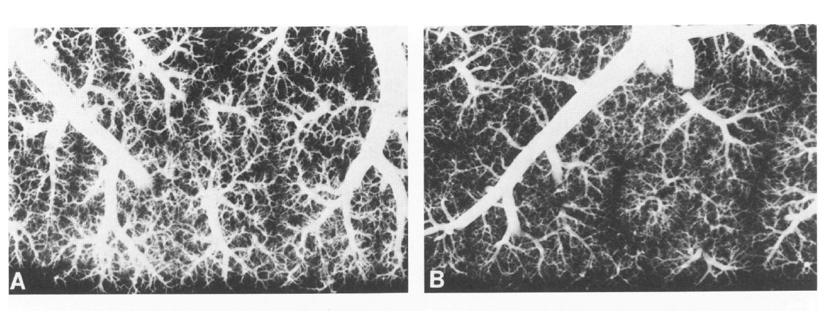
Figure 2-Microthrombosis.
A-Postmortem arteriogram of normal adult lung.
B-Arteriogram of a patient with early ARDS (6 days after aspiration). There are reduced filling of small arteries and prominent, edematous interlobular
septa.
TOMASHEFSKI Am J Pathol 1983
Notes:
The Pulmonary Vascular Lesions of the
Adult Respiratory Distress Syndrome
JOSEPH F. TOMASHEFSKI, Jr., MD,
Am J Pathol 1983 vol112 pp112

Slide 18
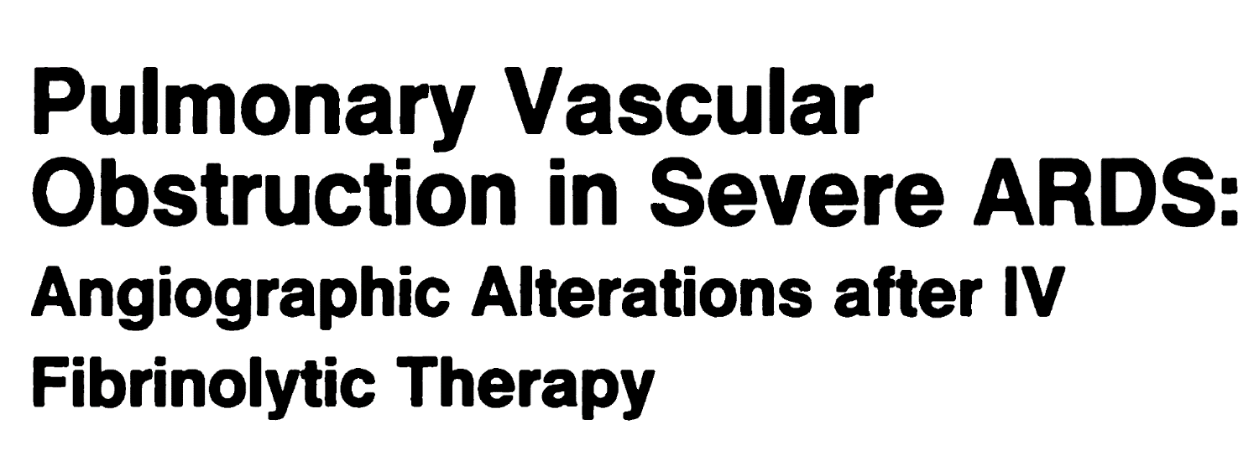

AJR 1987 148:501-508
We conclude that fibrinolytic infusion can lyse thrombi and possibly improve hemodynamics and oxygenation in ARDS-associated pulmonary vascular thrombosis.

Slide 19
Low dimers – low Crs
Low dimers – high Crs
high dimers – low Crs
high dimers – high Crs
Grasselli et al. Lancet Resp Med 2020

Slide 20
Grasselli et al. Lancet Resp Med 2020

Slide 21
ARDS : a pulmonary microvascular disease

Slide 22
CONCLUSION
Carbon Dioxide elimination is the true target of ventilation
Impairment of CO2 elimination is easily measured by Vd/Vt
Vd/Vt is a global index of pulmonary function, with important prognostic value
We ventilate our patients to eliminate CO2
The higher Vd/Vt the higher the Ventilation ( VILI!)

Slide 23
VILI
Ventilator Induced Lung Injury

Slide 24
Mechanical Ventilation
Biochemical Injury
(Biotrauma)
Biophysical
Injury
Epithelium/
interstitium
cytokines,
complement,
PGs, LTs, ROS,
proteases
shear
overdistention
cyclic stretch
Δ intrathoracic
  pressure
mφ
bacteria
alveolar-capillary
  permeability
cardiac output
organ perfusion
neutrophils
Distal Organ Dysfunction
Slutsky, Tremblay Am J Resp Crit Care Med. 1998;157:1721-5

Slide 25
PIP <30cmH20 (< 40 cm H20)
Vt as low as 350 ml (5 ml/kg)
SB (SIMV)
Often High RR - hypercapnia
Min PaO2/FiO2 Max PaCO2

Slide 26
PIP <30cmH20 (< 40 cm H20)
Vt as low as 350 ml (5 ml/kg)
SB (SIMV)
Often High RR - hypercapnia
Min PaO2/FiO2 Max PaCO2

Slide 27
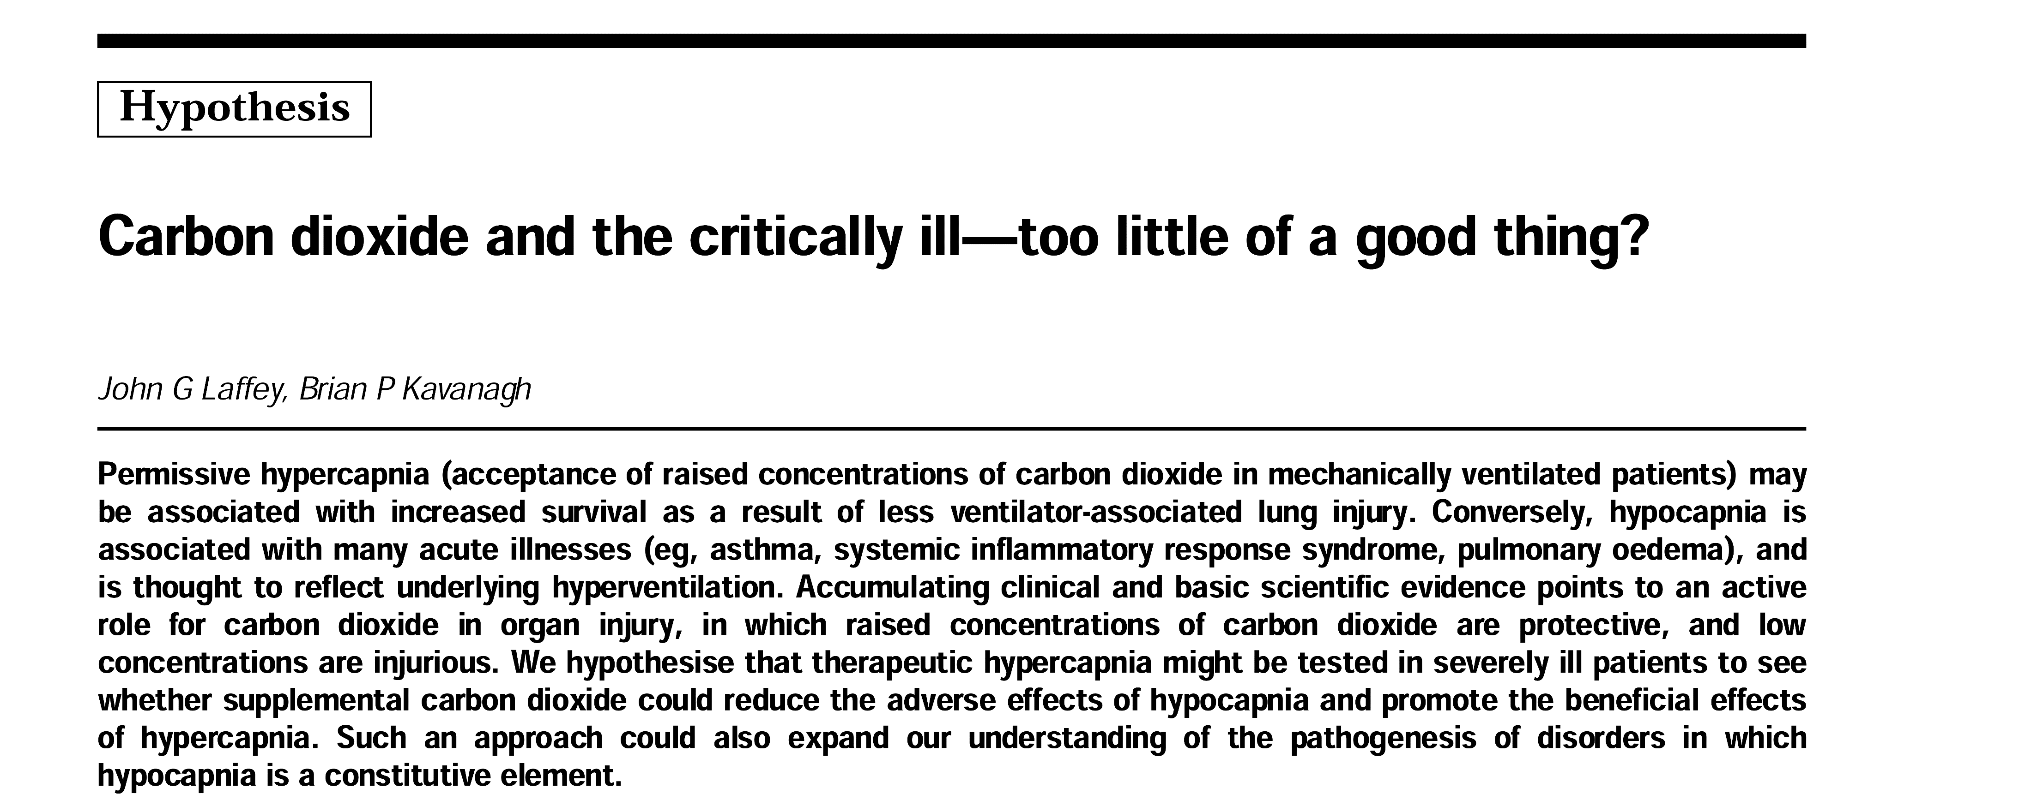
The Lancet 1999
John G Laffey , Brian P Kavanagh

Slide 28
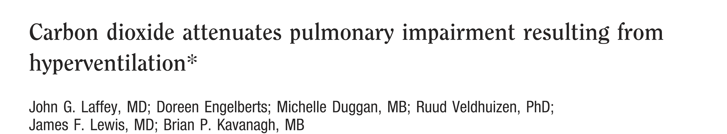
Rabbits 12ml/kg

Slide 29
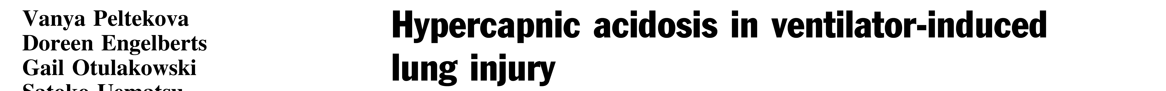
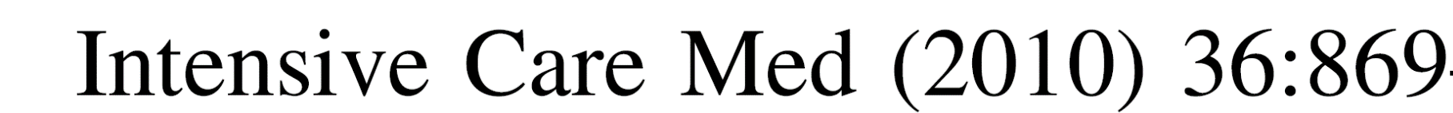

Slide 30


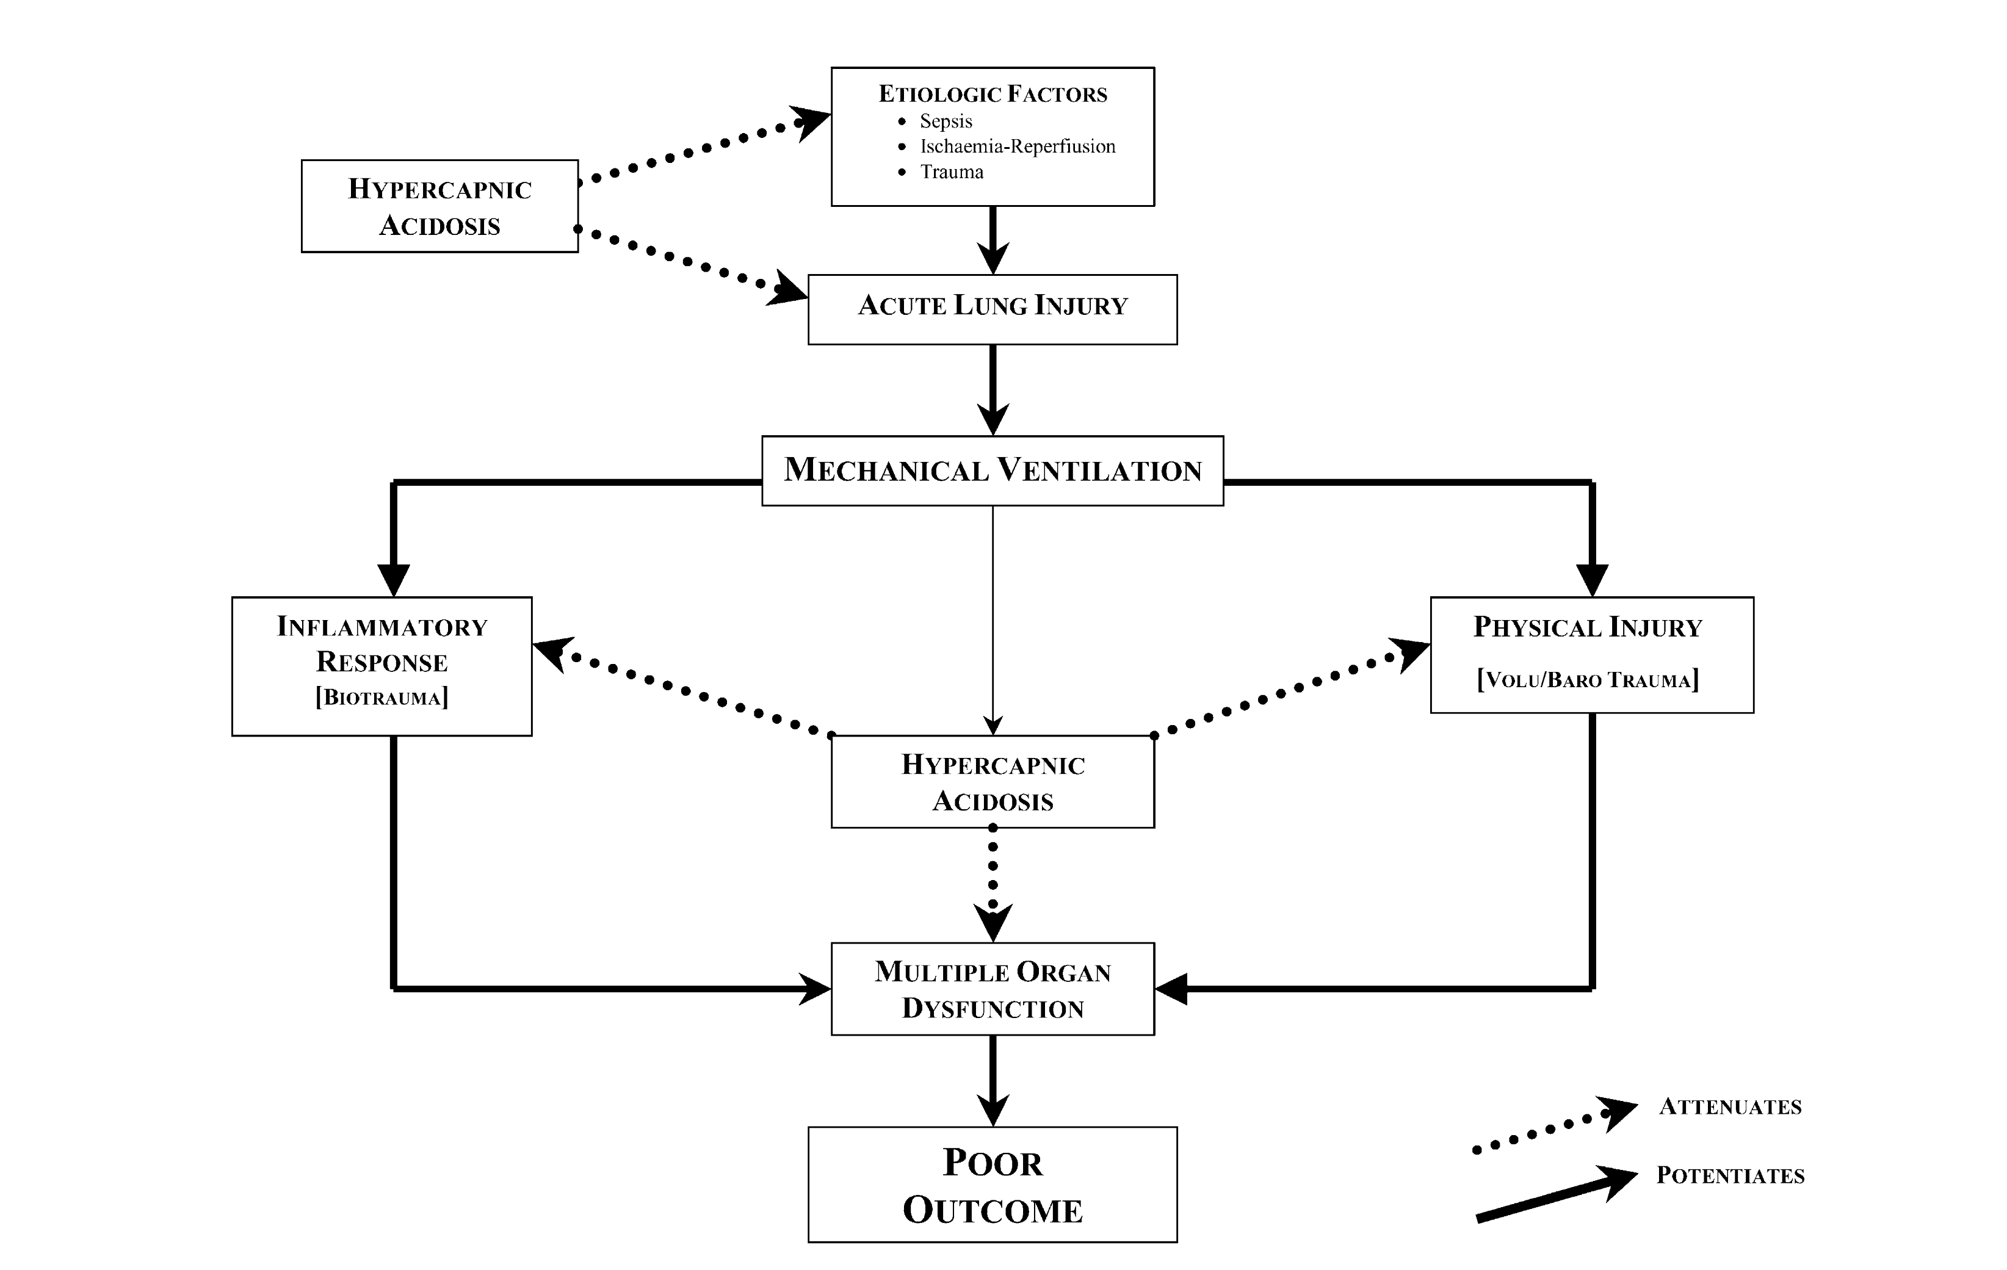

Slide 31
Hypercapnia modulates inflammation, independently of pH.
With sterile inflammation, hypercapnia may be of benefit
Hypercapnia may be deleterious in the setting of infection due to host immunosuppression.
Hypercapnia enhances bacterial and fungal virulence and survival
Hypercapnia may predispose humans to infections or worsen outcomes.
Payen Crit Care 2014

Slide 32
Hypercapnia modulates inflammation, independently of pH.
With sterile inflammation, hypercapnia may be of benefit
Hypercapnia may be deleterious in the setting of infection due to host immunosuppression.
Hypercapnia enhances bacterial and fungal virulence and survival
Hypercapnia may predispose humans to infections or worsen outcomes.
Payen Crit Care 2014

Slide 33
Hypercapnia modulates inflammation, independently of pH.
With sterile inflammation, hypercapnia may be of benefit
Hypercapnia may be deleterious in the setting of infection due to host immunosuppression.
Hypercapnia enhances bacterial and fungal virulence and survival
Hypercapnia may predispose humans to infections or worsen outcomes.
Payen Crit Care 2014

Slide 34
Hypercapnia modulates inflammation, independently of pH.
With sterile inflammation, hypercapnia may be of benefit
Hypercapnia may be deleterious in the setting of infection due to host immunosuppression.
Hypercapnia enhances bacterial and fungal virulence and survival
Hypercapnia may predispose humans to infections or worsen outcomes.
Payen Crit Care 2014

Slide 35
Hypercapnia modulates inflammation, independently of pH.
With sterile inflammation, hypercapnia may be of benefit
Hypercapnia may be deleterious in the setting of infection due to host immunosuppression.
Hypercapnia enhances bacterial and fungal virulence and survival
Hypercapnia may predispose humans to infections or worsen outcomes.
Payen Crit Care 2014

Slide 36
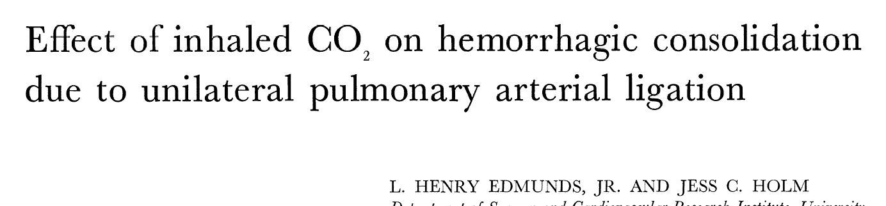


Slide 37


Slide 38
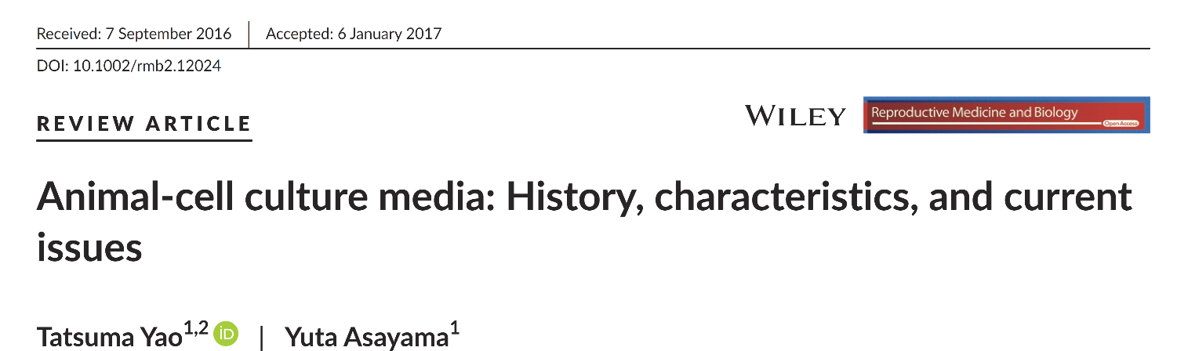
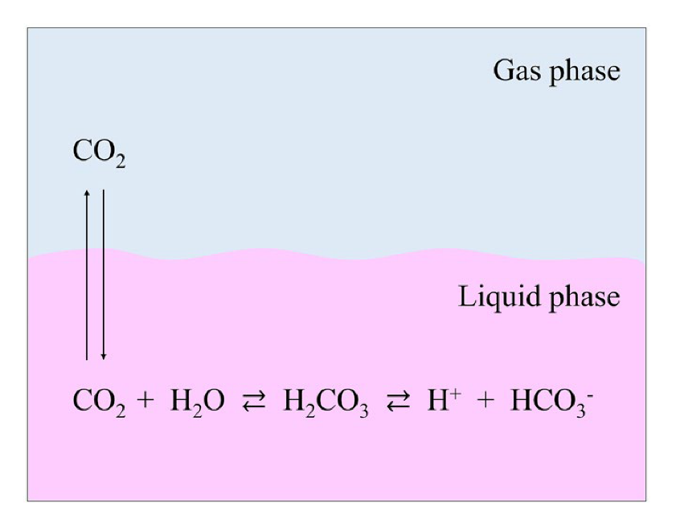

Slide 39
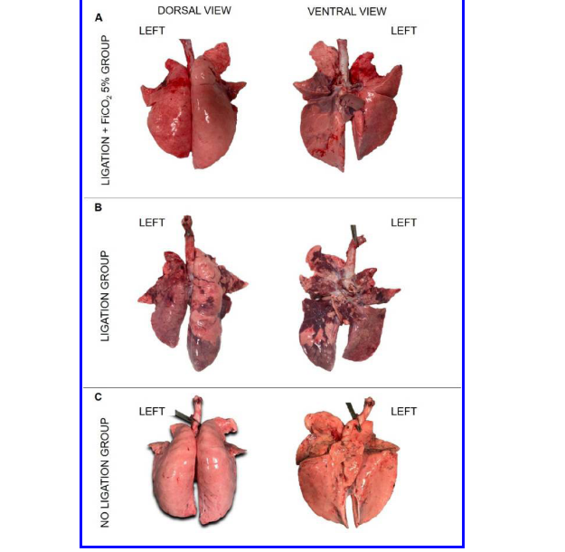
Addition of 5% CO2 to Inspiratory Gas
Prevents Lung Injury in an Experimental Model of
Pulmonary Artery Ligation
Ligation +
CO2
Ligation
control
Marongiu I: AJRCCM 2021 .
Notes:
Abstract
Rationale: Unilateral ligation of the pulmonary artery may induce lung injury through
multiple mechanisms, which might be dampened by inhaled CO2.
Objectives: To characterize bilateral lung injury due to unilateral ligation of pulmonary
artery in healthy swine undergoing controlled mechanical ventilation and its prevention by
5% CO2 inhalation. To investigate relevant pathophysiological mechanisms.
Methods: Sixteen healthy pigs were allocated to surgical ligation of the left pulmonary artery
(Ligation group), 7 to surgical ligation of the left pulmonary artery and inhalation of 5% CO2
(Ligation + FiCO2 5%), and 6 to no intervention (No Ligation). Then, all animals received
mechanical ventilation with tidal volume (Vt) 10 ml/Kg, positive end-expiratory pressure 5
cmH2O, respiratory rate 25 bpm and FiO2 50% (±FiCO2 5%) for 48 hours or until
development of severe lung injury.
Measurements and main results: Histological, physiological and quantitative CT-scan data
were compared between groups to characterize lung injury. Electrical impedance tomography
and immunohistochemistry analysis were performed in a subset of animals to explore
mechanisms of injury.
Animals from the Ligation group developed bilateral lung injury as assessed by significantly
higher histological score, larger increase in lung weight, poorer oxygenation, and worse
respiratory mechanics in comparison to the Ligation + FiCO2 5% group.
In the Ligation group, the right lung received larger fraction of Vt, and inflammation was
more represented, while CO2 dampened both processes.
Page 4 of 60
AJRCCM Articles in Press. Published July 12, 2021 as 10.1164/rccm.202101-0122OC
Copyright © 2021 by the American Thoracic Society
Conclusions: Mechanical ventilation induces bilateral lung injury within 48 hours in healthy
pigs undergoing left pulmonary artery ligation. Inhalation of 5% CO2 prevents injury, likely
through decreased stress to the right lung and anti-inflammatory effects.
Abstract word count: 251
Key words: VILI, pulmonary perfusion, CO2 inhalation, therapeutic hypercapnia

Slide 40
Ligation +
CO2
Ligation
control
Marongiu I: AJRCCM 2021 .
Notes:
Abstract
Rationale: Unilateral ligation of the pulmonary artery may induce lung injury through
multiple mechanisms, which might be dampened by inhaled CO2.
Objectives: To characterize bilateral lung injury due to unilateral ligation of pulmonary
artery in healthy swine undergoing controlled mechanical ventilation and its prevention by
5% CO2 inhalation. To investigate relevant pathophysiological mechanisms.
Methods: Sixteen healthy pigs were allocated to surgical ligation of the left pulmonary artery
(Ligation group), 7 to surgical ligation of the left pulmonary artery and inhalation of 5% CO2
(Ligation + FiCO2 5%), and 6 to no intervention (No Ligation). Then, all animals received
mechanical ventilation with tidal volume (Vt) 10 ml/Kg, positive end-expiratory pressure 5
cmH2O, respiratory rate 25 bpm and FiO2 50% (±FiCO2 5%) for 48 hours or until
development of severe lung injury.
Measurements and main results: Histological, physiological and quantitative CT-scan data
were compared between groups to characterize lung injury. Electrical impedance tomography
and immunohistochemistry analysis were performed in a subset of animals to explore
mechanisms of injury.
Animals from the Ligation group developed bilateral lung injury as assessed by significantly
higher histological score, larger increase in lung weight, poorer oxygenation, and worse
respiratory mechanics in comparison to the Ligation + FiCO2 5% group.
In the Ligation group, the right lung received larger fraction of Vt, and inflammation was
more represented, while CO2 dampened both processes.
Page 4 of 60
AJRCCM Articles in Press. Published July 12, 2021 as 10.1164/rccm.202101-0122OC
Copyright © 2021 by the American Thoracic Society
Conclusions: Mechanical ventilation induces bilateral lung injury within 48 hours in healthy
pigs undergoing left pulmonary artery ligation. Inhalation of 5% CO2 prevents injury, likely
through decreased stress to the right lung and anti-inflammatory effects.
Abstract word count: 251
Key words: VILI, pulmonary perfusion, CO2 inhalation, therapeutic hypercapnia

Slide 41
Marongiu I: AJRCCM 2021 Jul 12.
Notes:
Abstract
Rationale: Unilateral ligation of the pulmonary artery may induce lung injury through
multiple mechanisms, which might be dampened by inhaled CO2.
Objectives: To characterize bilateral lung injury due to unilateral ligation of pulmonary
artery in healthy swine undergoing controlled mechanical ventilation and its prevention by
5% CO2 inhalation. To investigate relevant pathophysiological mechanisms.
Methods: Sixteen healthy pigs were allocated to surgical ligation of the left pulmonary artery
(Ligation group), 7 to surgical ligation of the left pulmonary artery and inhalation of 5% CO2
(Ligation + FiCO2 5%), and 6 to no intervention (No Ligation). Then, all animals received
mechanical ventilation with tidal volume (Vt) 10 ml/Kg, positive end-expiratory pressure 5
cmH2O, respiratory rate 25 bpm and FiO2 50% (±FiCO2 5%) for 48 hours or until
development of severe lung injury.
Measurements and main results: Histological, physiological and quantitative CT-scan data
were compared between groups to characterize lung injury. Electrical impedance tomography
and immunohistochemistry analysis were performed in a subset of animals to explore
mechanisms of injury.
Animals from the Ligation group developed bilateral lung injury as assessed by significantly
higher histological score, larger increase in lung weight, poorer oxygenation, and worse
respiratory mechanics in comparison to the Ligation + FiCO2 5% group.
In the Ligation group, the right lung received larger fraction of Vt, and inflammation was
more represented, while CO2 dampened both processes.
Page 4 of 60
AJRCCM Articles in Press. Published July 12, 2021 as 10.1164/rccm.202101-0122OC
Copyright © 2021 by the American Thoracic Society
Conclusions: Mechanical ventilation induces bilateral lung injury within 48 hours in healthy
pigs undergoing left pulmonary artery ligation. Inhalation of 5% CO2 prevents injury, likely
through decreased stress to the right lung and anti-inflammatory effects.
Abstract word count: 251
Key words: VILI, pulmonary perfusion, CO2 inhalation, therapeutic hypercapnia

Slide 42
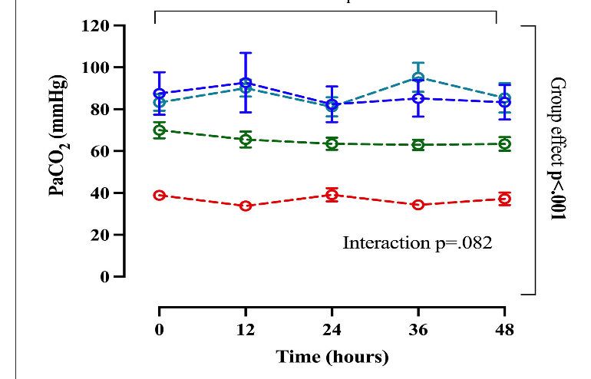
Inhaled CO2 vs. Hypercapnia Unilateral Pulmonary Artery Ligation
6 pigs Vt 10 ml/kg
7 pigs Vt 10 ml/Kg + 5% CO2
6 pigs Vt 6 ml/Kg
6 pigs Vt 10 ml/kg + Dead space
Spinelli et al Frontiers in Medcine 2022

Slide 43
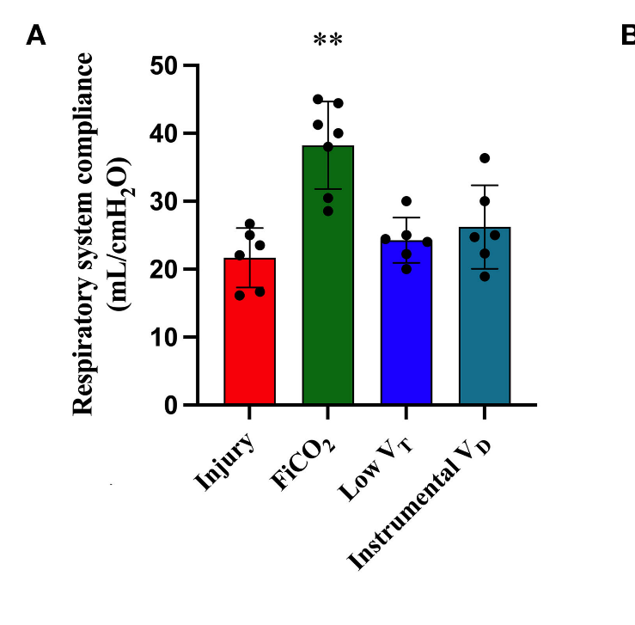
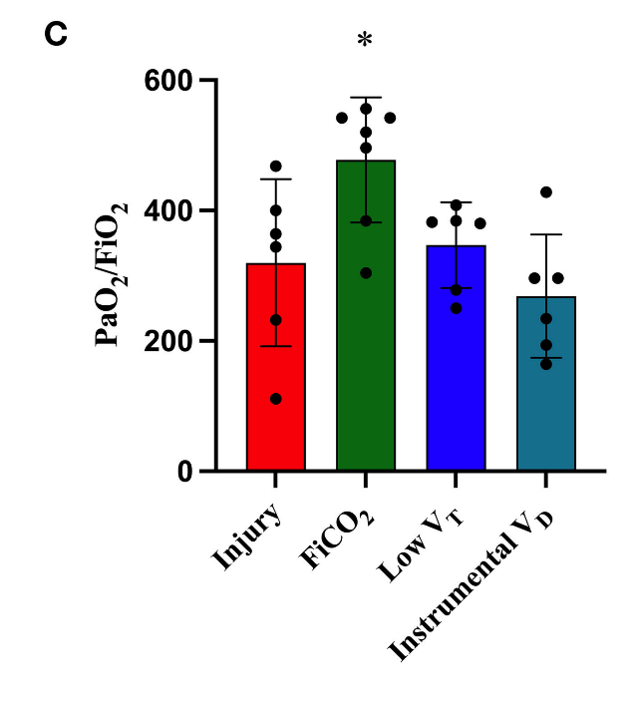
Inhaled CO2 vs. Hypercapnia Unilateral Pulmonary Artery Ligation
Spinelli et al Frontiers in Medcine 2022

Slide 44
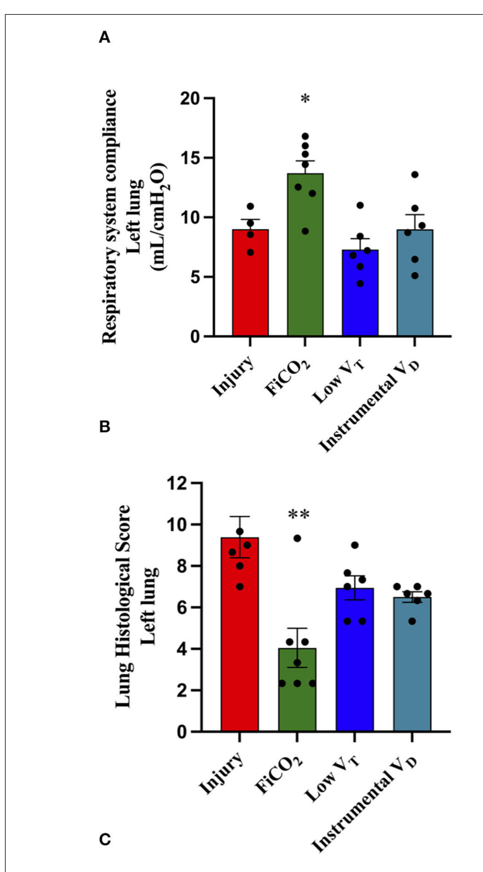
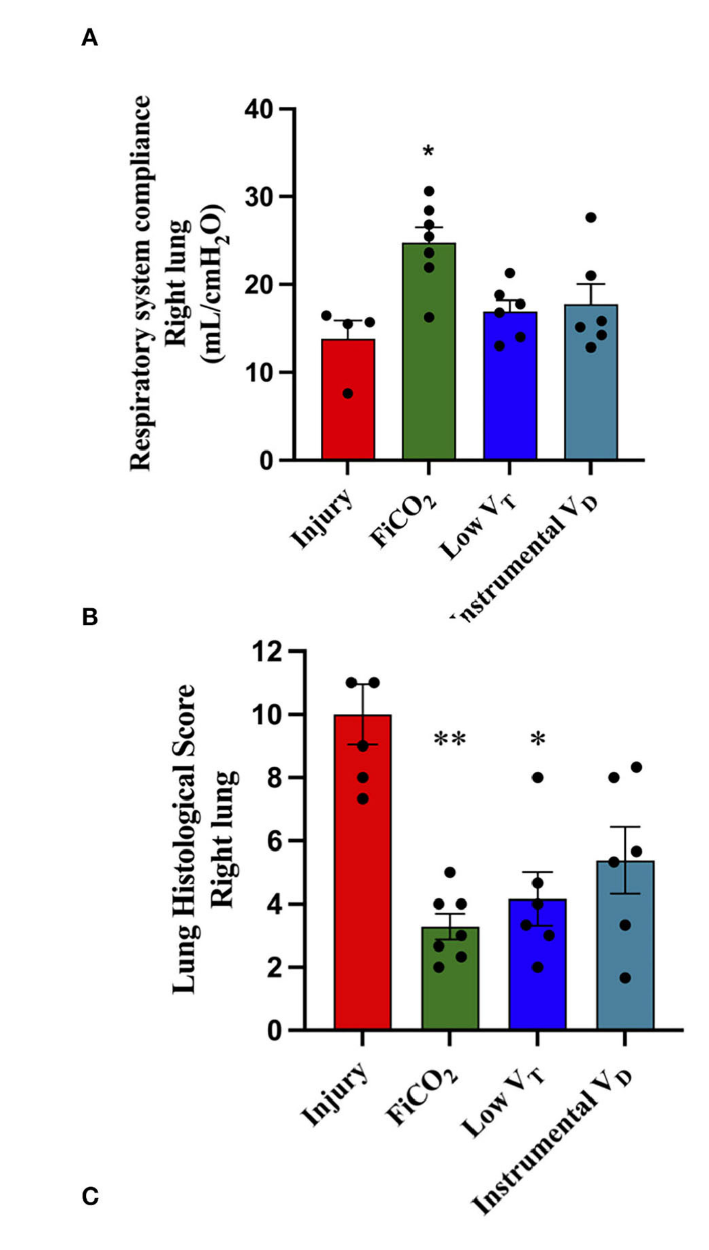
Left Lung Right Lung
Spinelli et al Frontiers in Medicine 2022

Slide 45
Inhaling 5% CO2
Dead space not exposed to severe hypocapnia
Oxygenation is maintained
If PaCO2 normal no Co2 elimination by the natural lung

Slide 46
Thinking outside the box
Ventilate at low frequency (4-8 bpm)?
Should we ventilate patients on ECMO/ ECCO2R with 5% CO2?
Will 5% CO2 in the inspired air protect the high Va/Q regions?
Will 5% Co2 decrease VILI?

Slide 47

5 % CO2
%5
%

Slide 50
Addition of 5% CO2 to Inspiratory Gas Prevents Lung Injury in an Experimental Model of Pulmonary Artery Ligation
Marongiu I MD Am J Respir Crit Care Med. 2021 :204:933.
.

Slide 51
Addition of 5% CO2 to Inspiratory Gas Prevents Lung Injury in an ExperimentalModel of Pulmonary Artery Ligation
Ines Marongiu MD
Am J Respir Crit Care Med. 2021 Jul 12. ahead of print
.

Slide 52
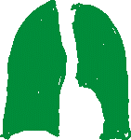



Slide 54
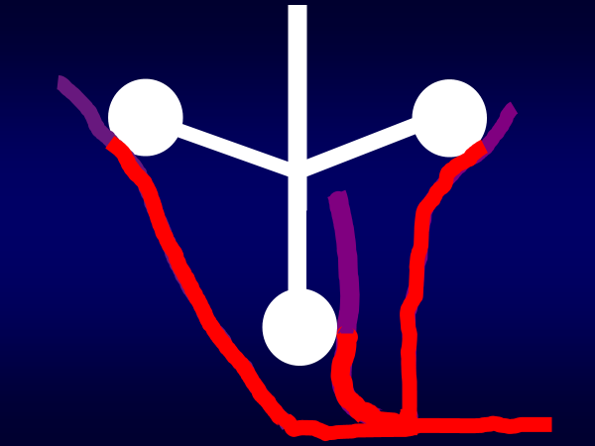

Slide 57
VCO2= 240 ml/min
Ve= Vd Alv + Vd anat+ VA
13.025 L = 6.125 + 2.0 + 4.9 L
Vd anat = 2L
VD ALV
2 L
VA = 2 L
PACO2 43
PcCO2= 35 mmHg
PvCO2= 49 mmHg
ART PaCO2 = 43mmHg

