Slide 1


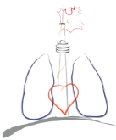


Place of respiratory physiology in Intensive Care
Laurent Brochard

Slide 2



Slide 3

Conflicts of interest
Our clinical research laboratory has received equipment
or research grants for clinical research projects from the
following companies:
  Covidien (PAV+)
  Draeger (EIT)
  Vitalaire
  Stimit
  Sentec (tcPCO2)
  Philips (Sleep)
  Fisher Paykel (Optiflow)

Slide 4

Physiology remains an important and feasible means to understand and predict heterogeneity of treatment effect. It has a proven record of success and can be used in real time to monitor and tailor treatment.

Slide 5
Are physiological variables good surrogates for outcomes?

Slide 6


Slide 7
PaO2/FiO2 ratio in ARDS: comparison of two ventilatory modes
PaO2/FiO2 (mm Hg)
Vt 12
Vt 6

Slide 8
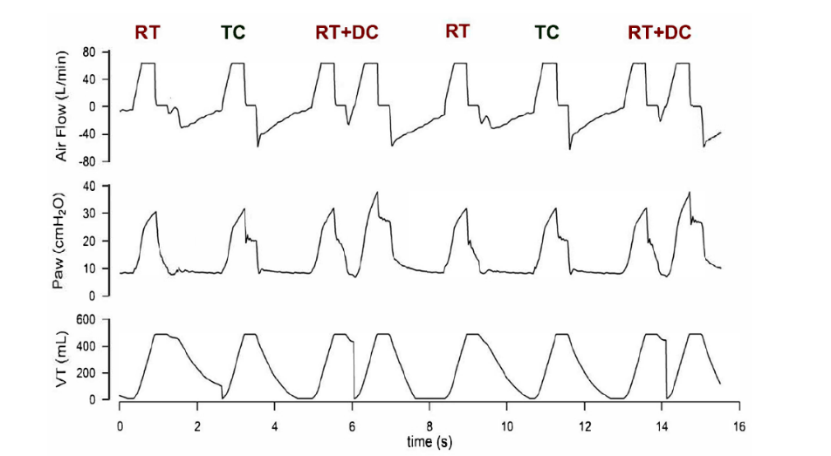

Slide 9

Digitization is the process of converting information into a digital format. The result is the representation of an object, image, sound, document or signal by generating a series of numbers that describe a discrete set of points or samples.
Reading of an analog signal is performed at regular time intervals (frequency), sampling the value of the signal at the point.
Claude Elwood Shannon
(1916 – 2001)
A Mathematical Theory of Communication

Slide 10
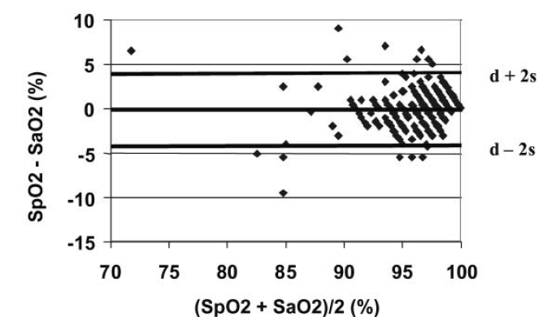
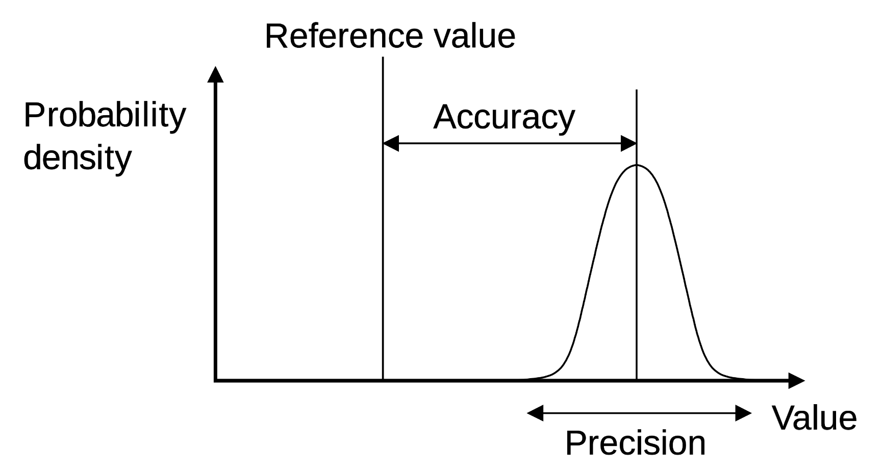
Van de Louw ICM 2001
Accuracy is the proximity of measurement results to the true value; precision, the repeatability,
or reproducibility of the measurement

Slide 11
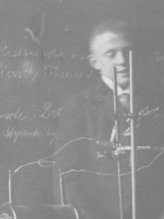
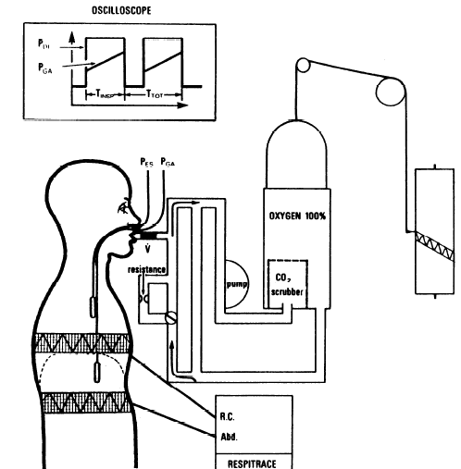
Heisenberg principle
The more precisely the position is determined, the less precisely the momentum is known in this instant, and vice versa.
-- Heisenberg, uncertainty paper, 1927
Heisenberg, Habilitation 1924
(Thesis discussed both the stability of laminar
flow and the nature of turbulent flow)

Slide 12
Is physiology a good guide for our management?

Slide 13


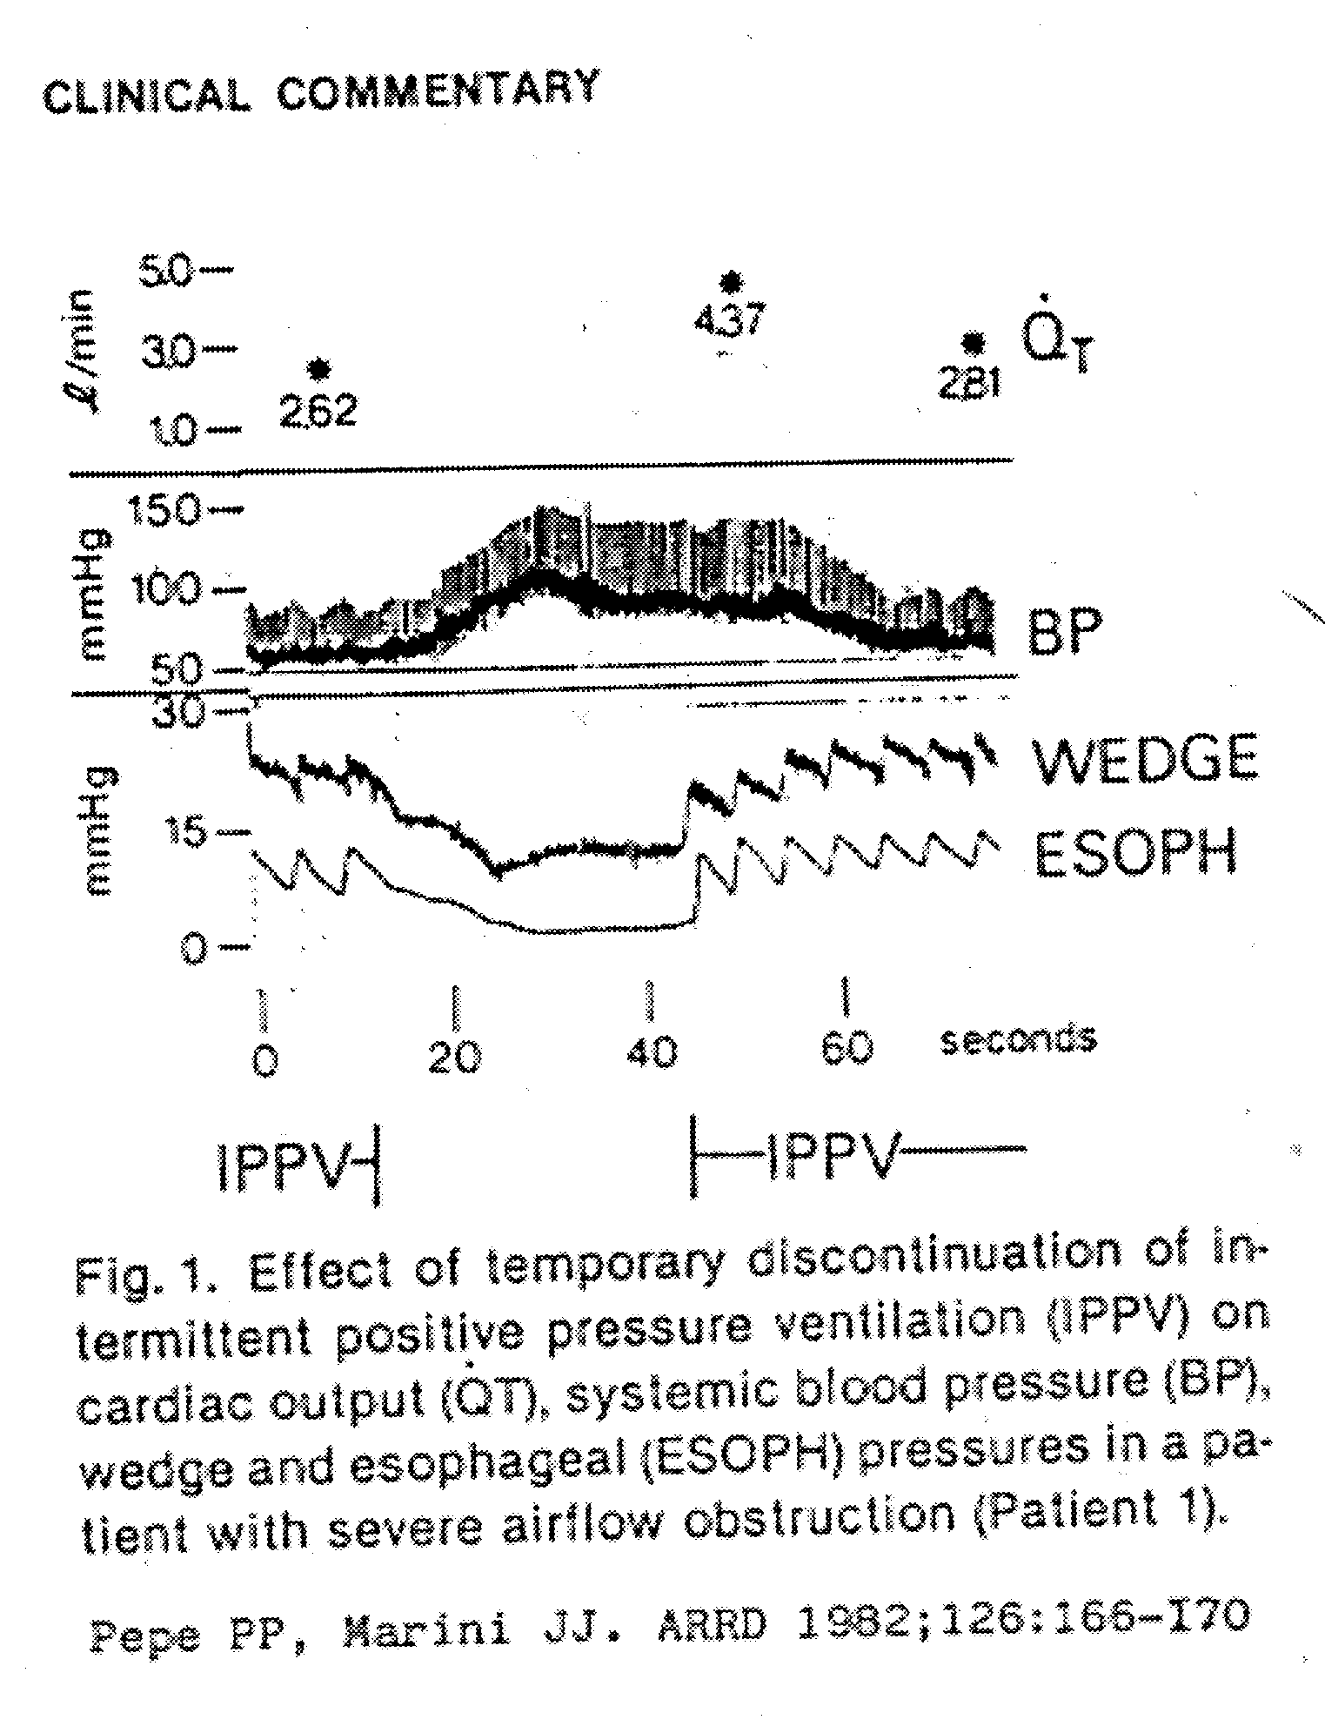
Occult positive end-expiratory pressure in mechanically ventilated patients with airflow obstruction: the auto-PEEP effect.

Slide 14

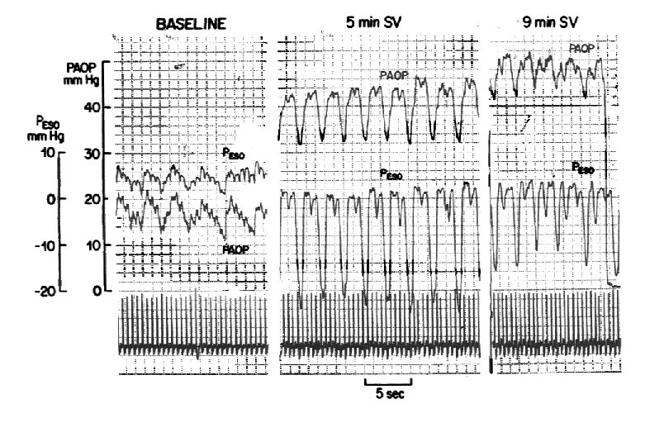
Acute LV dysfunction during unsuccessful weaning from MV
F Lemaire, JL Teboul, WM Zapol et al. ANESTHESIOL.1988; 69:171

Slide 15

Ventilator-induced lung injury: from the bench to the bedside
Tremblay, Slustky ICM 2006

Slide 16



Slide 17
Why physiology should continue to challenge our dogma/guidelines/good practices/etc.?

Slide 18

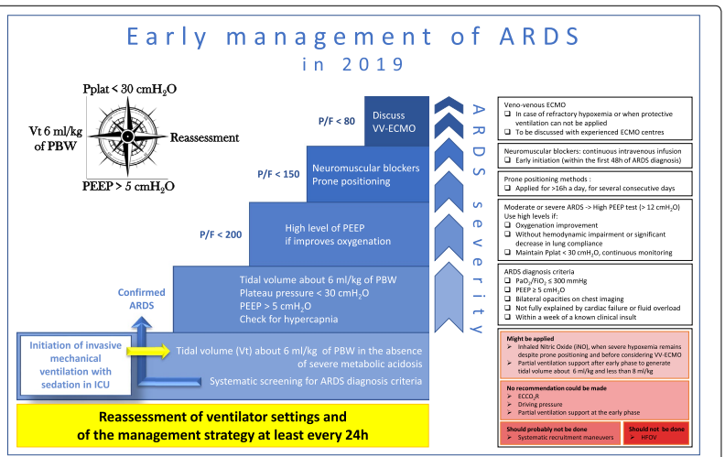

Slide 19
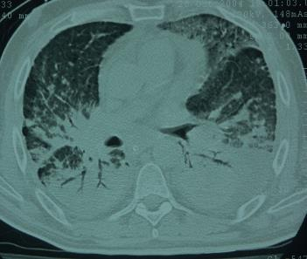
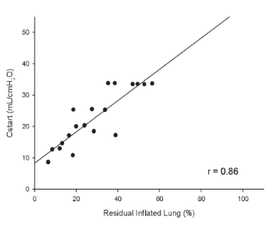
ARDS : “baby lung”
Low compliance in ARDS : small lung not stiff lung
Gattinoni L and Pesenti A. The concept of « baby lung » ICM 2005

Slide 20
Compliance
C= Vt/DP
DP= Vt/C

Slide 21


Slide 22
Compliance / Elastance
C= Vt/DP
E= DP/Vt
E= DP (cmH2O) / Vt (L)
Normalized E = DP/Vt ml/kg PBW
Normal ≈ 1 cmH2O/ml/kg PBW

Slide 23

Goligher E. AJRCCM 2022

Slide 24
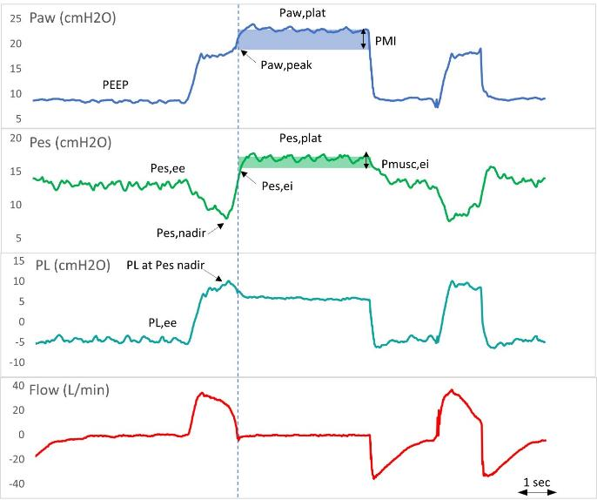


Plateau pressure
Measurement
during
Pressure Support Ventilation
A. Grassi, I Bianchi et al. JCC

Slide 25


Slide 26

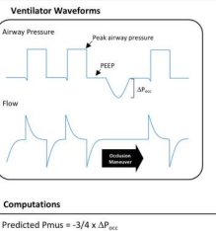
Predicted Pmus= -3/4 ΔPocc

Slide 27

Precision Medicine is not possible without Clinical Bedside Physiology

